Slide 1
CAR 163916135 Finding

Slide 2
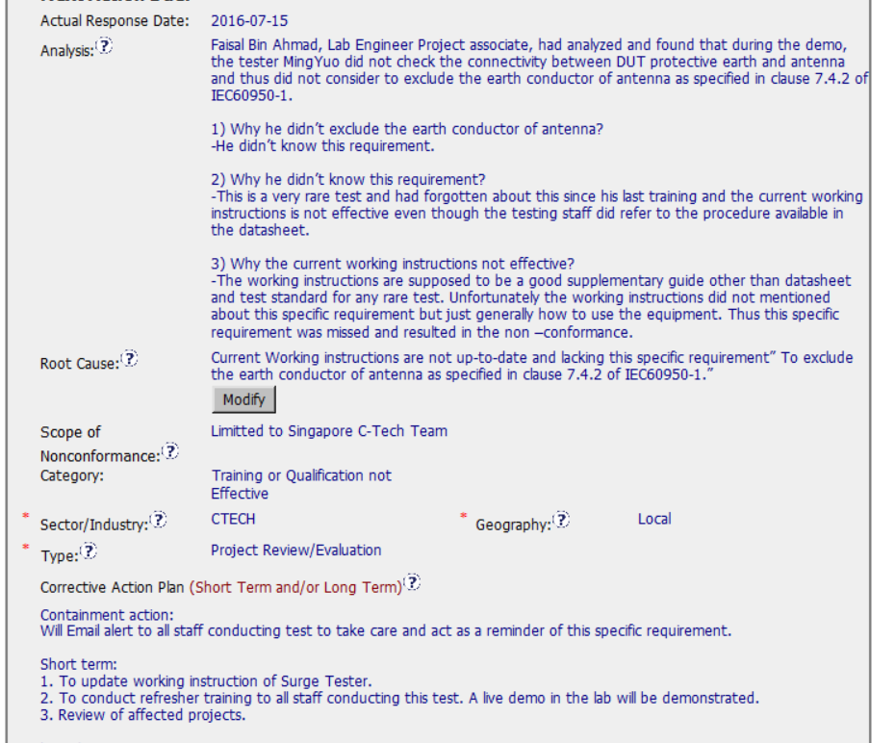
Proper stakeholder identified
Root cause analysis conducted
Concise Statement pointing to the system issue
Type should be Testing (internal UL)
Plan includes Containment
Including the review of previous project

Slide 3
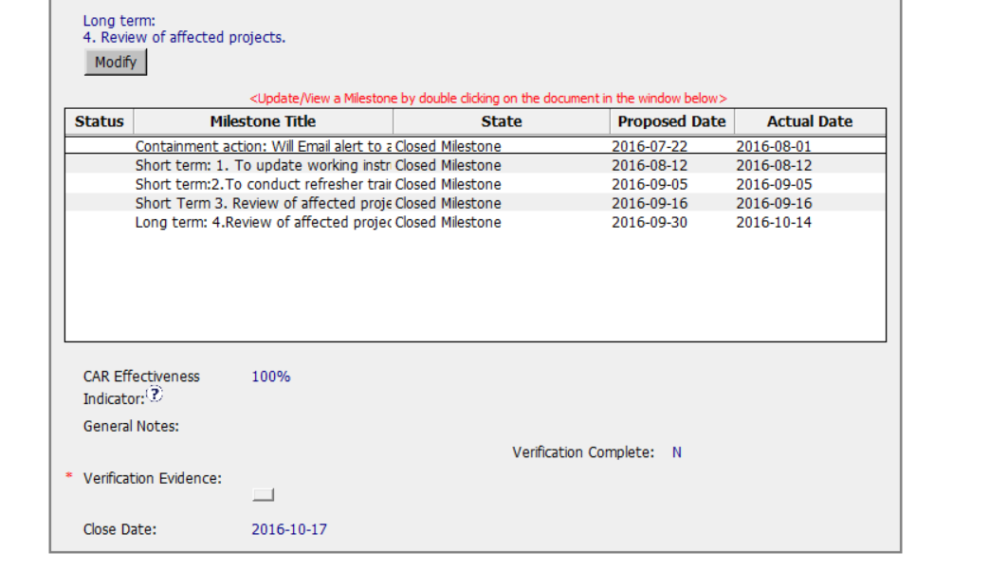
No verification by owner in the plan
Milestone completion mostly on time ( 2 overdue)
Not sure “100%” means

Slide 4
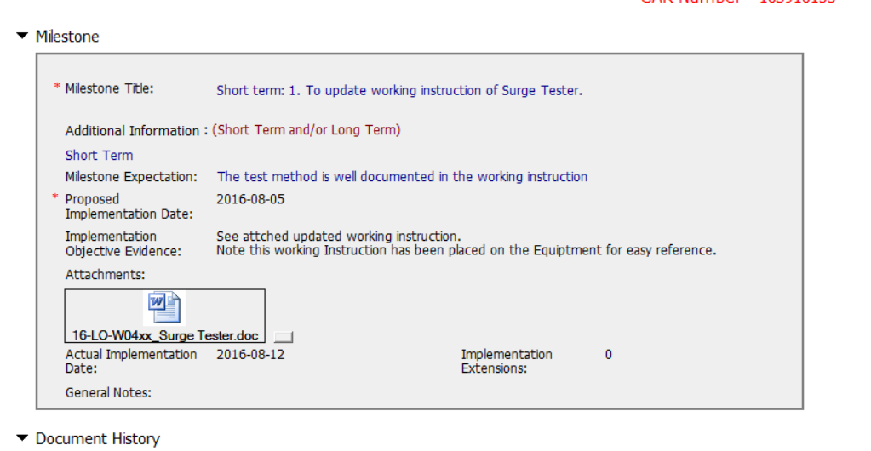
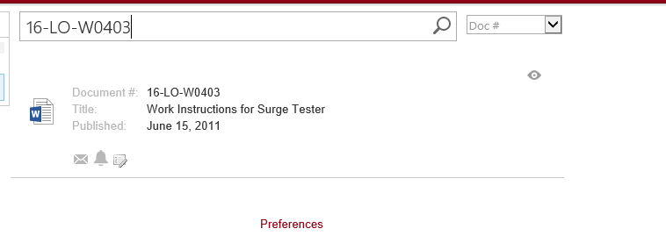
Document was not published, but the milestone was accepted

Slide 5
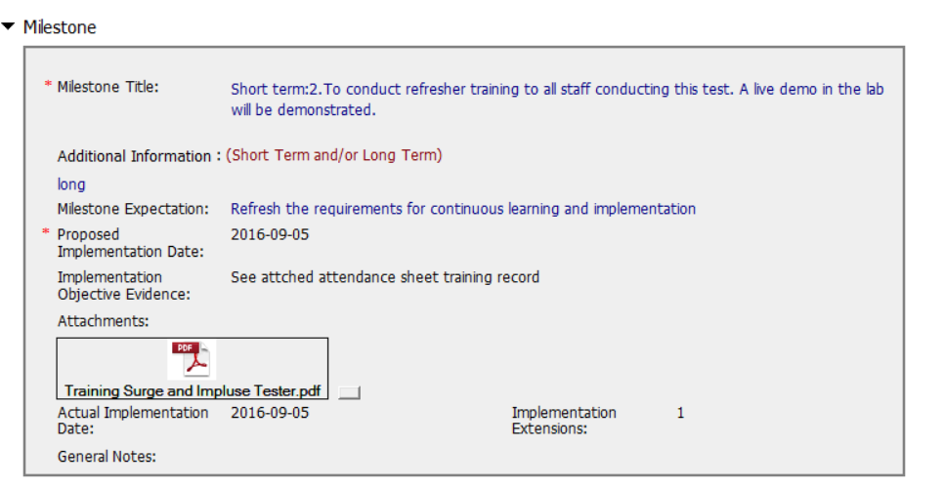
No training content was provided. No evidence that demo was conducted

Slide 6
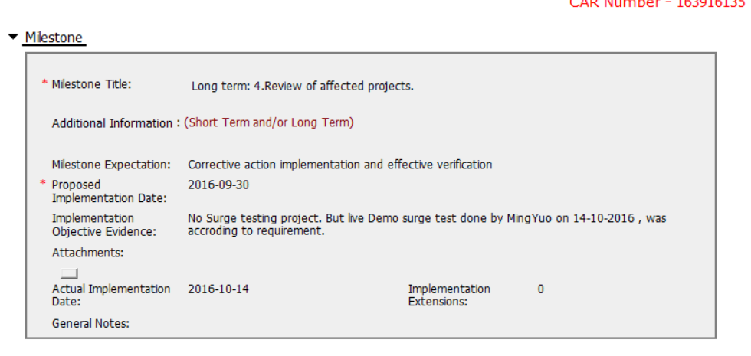
Clear expectation could help the CAR owner for effectiveness verification.

Slide 7
Internal Testing may be selected for Type
Document needs to be published before milestone is closed
The second CAR champion took over the job when staff left UL.
Communication of overdue should be documented in GCAR database

Slide 8
CAR 163916135 (Finding)

Slide 9
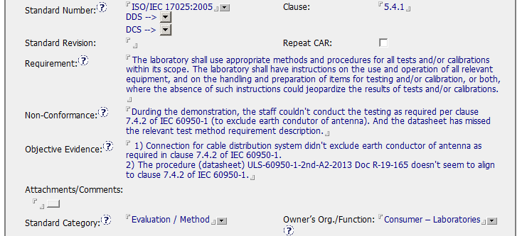
CAR 163916135

Slide 10
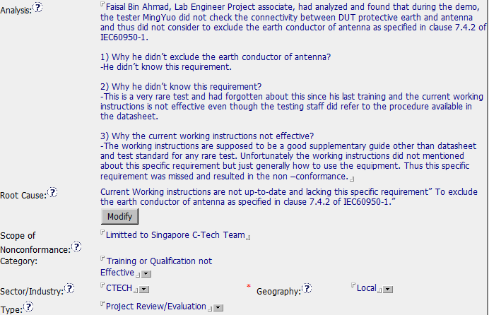
CAR 163916135
Stakeholders not identified
5 Why analysis approach, leads to Root Cause ☺

Slide 11
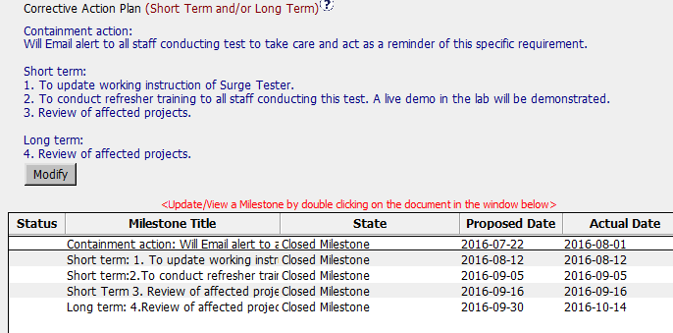
CAR 163916135
Nicely organized CAP and MS

Slide 12
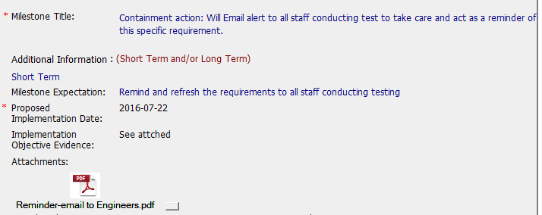
CAR 163916135
Expectation could be more clear: Only email was sent, should also have evidence of email reply/confirmations of the receivers.

Slide 13
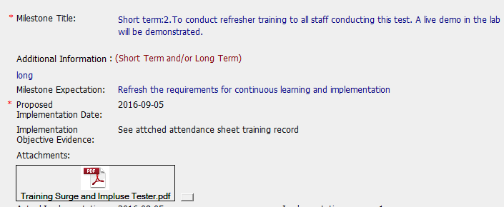
CAR 163916135
Training record signed by all attendees ☺

Slide 14
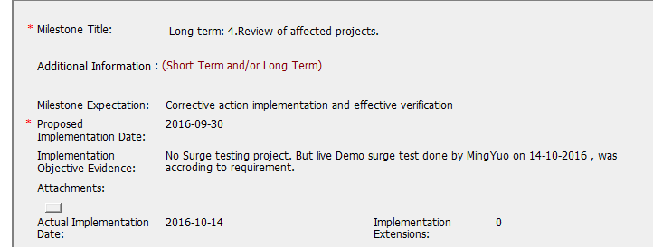
CAR 163916135
Would be better to:
Title “Verification”
Only 1 month for this check, 2 or 3 months preferred.
Include demo test datasheet.

Slide 15
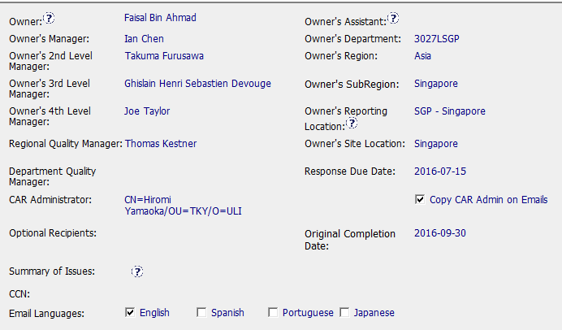
CAR 163916135
CAR has correct management path

Slide 16
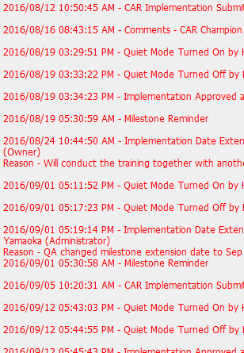
CAR 163916135
Document History
Extensions facilitated,
however, some dates changed without Reason-.
Overdue/Escalated Notification had no CAR Champion comment.

Slide 17
Once Analysis, CAP, and Milestones were finalized, this CAR was generally smoothly completed.
CAR 163916135
CBS Requirements | Excellent | Moderate | Need Improve | N/A
(C) Extensions are within requirement (<30 days, 3 or less) | √
(T) Most appropriate ‘category’, ‘type’, ‘geography’ are selected | √
(P) Facilitates the handling of disputed CARs |  |  |  | √
(T) Acts on CARs within required timeframe | √
(C) Analysis shows clear path to root cause and scope; stakeholders identified | √
(C) Root cause statement is succinct, reasonable, complete | √
(C) Corrective actions fix the objective evidence and other problems found; address entire root cause and scope. For observations, they do not go beyond fixing the objective evidence | √
(C) Milestones address containment & owner’s verification; completed per milestone expectations | √
(P) Verification per requirements |  | √
(L) Referenced communications are attached as needed | √
(C L) Evidence of communication for overdue/escalated CARs and other pertinent concerns |  | √
(P) Trains other CAR Champions |  |  |  | √

